Slide 1
Applying Lean Methodologies in Marketing
Maximizing resources and minimizing costs for creative growth

Slide 2
Lean approach: a catalyst for marketing innovation.
Lean methodologies’ role in freeing up time and money.
Focusing resources on value adding actions.
Overview of Hoshin, Value Stream Mapping, Kaizen & Kanban.

Slide 3
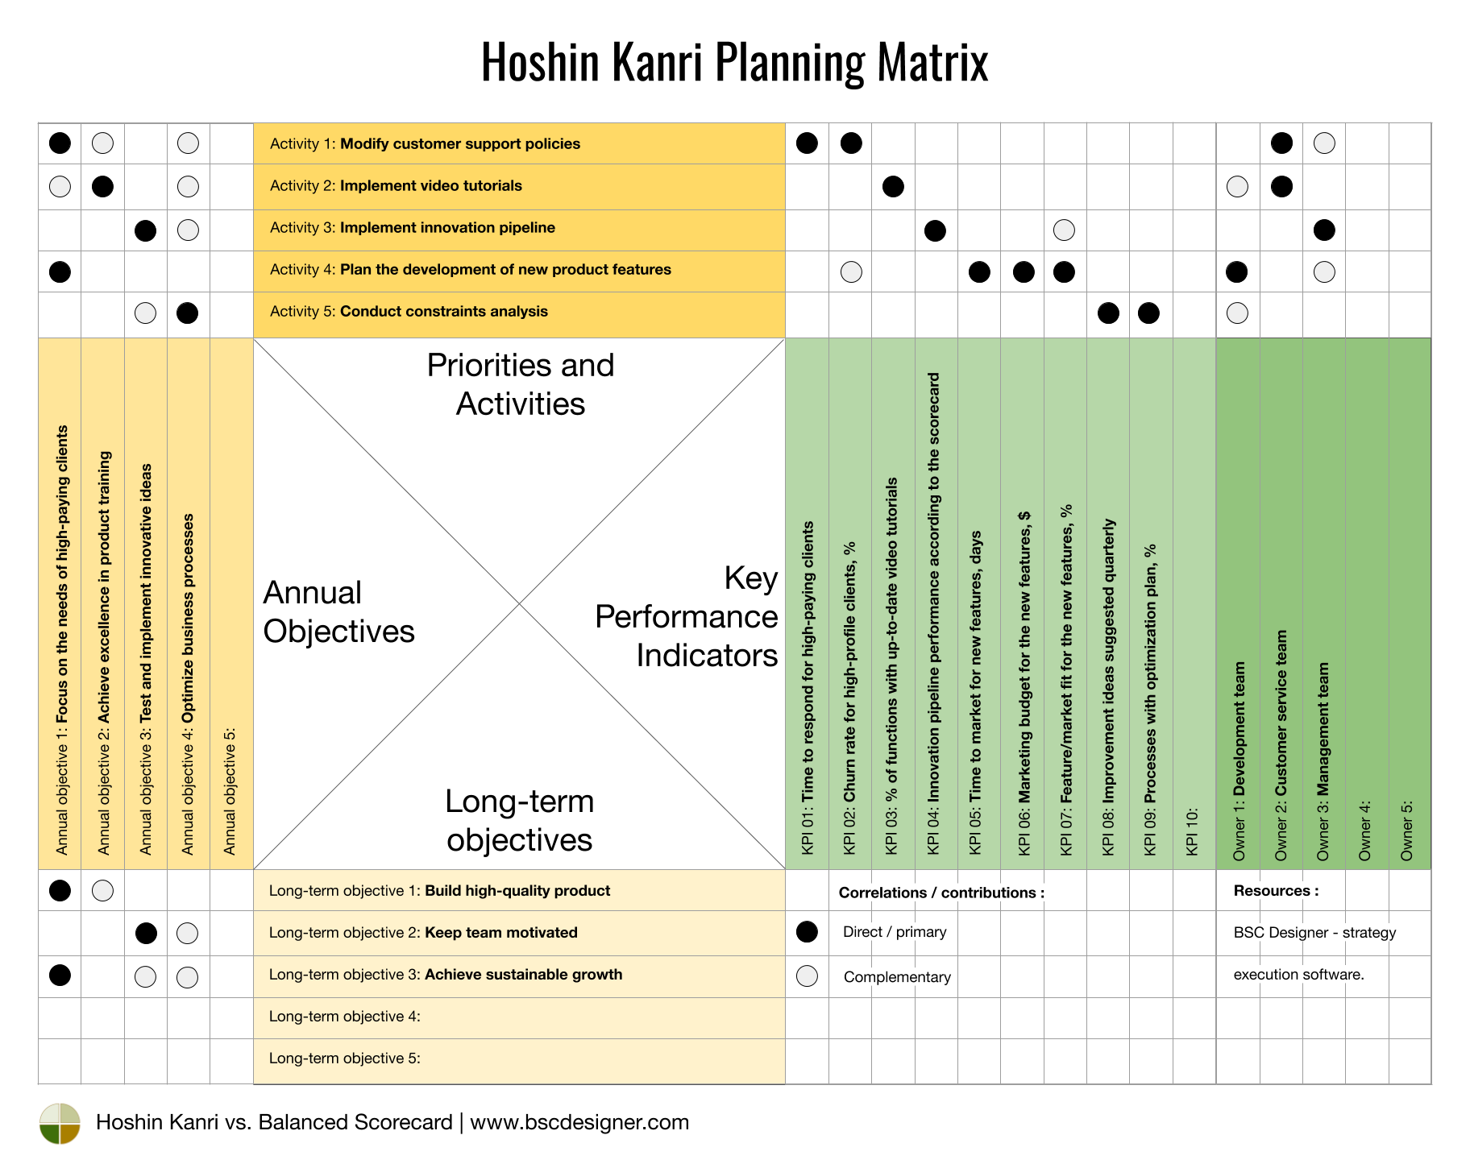
Hoshin Matrix
Links
Long-term goals to
Annual objectives to
KPI's to
Responsible team members

Slide 4
Value Stream Mapping: Streamlining for Efficiency
Core concept:
Principles:
Identify value-adding and non-value-adding marketing activities to enhance efficiency and terminate waste.
Methods:
Leveraging data systems to measure added value/loyalty per marketing interaction/consumption/technology.
Streamlining processes to maximize efficiency.

Slide 5
Kaizen: Driving Continuous Improvement in Marketing
Definition:
Principles:
Small, incremental changes for long-term improvements.
Emphasizes sustainable growth over quick fixes.
Benefits:
Adapts to changing market dynamics and consumer behaviors.
Encourages innovative thinking and problem-solving.
Kaizen - a Japanese term meaning 'change for the better' or 'continuous improvement’.

Slide 6
Kanban: Enhancing Marketing Productivity
Core Concept:
Visualization of marketing tasks.
Focus on reducing task-switching and enhancing process efficiency.
Process Steps:
Visualize the Workflow
Benefits:
Improved clarity on marketing tasks and priorities.
Faster turnaround times and reduced project backlog.
Limit Work-in-Progress (WIP)
Manage and Measure Flow
Notes:
Concept:
Visualization of marketing tasks.
Focus on reducing task-switching and enhancing process efficiency.
Process:
Visualize the Workflow: Create a Kanban board with columns representing different stages of the marketing process.
Limit Work-in-Progress (WIP): Set maximum limits for tasks in each stage to prevent overloading and ensure focus.
Manage and Measure Flow: Monitor the movement of tasks and identify bottlenecks for improvement.
Benefits:
Improved clarity on marketing tasks and priorities.
Faster turnaround times and reduced project backlog

Slide 7
Applying Lean in marketing leads to cost reduction and value increase
Efficiency and Streamlining (Value Stream Mapping):
By identifying and eliminating non-value-adding activities, marketing processes become more streamlined, reducing wasted time and resources.
Continuous Improvement (Kaizen):
Ongoing incremental improvements ensure that marketing strategies are always evolving and adapting, enhancing their effectiveness and ROI.
Workflow Optimization (Kanban):
Visual management of tasks and limiting work-in-progress prevent bottlenecks and improve workflow efficiency, enabling faster project completion and better resource allocation.
Team focus (Hoisin matrix):
By linking the long-term goals with yearly objectives, kpis, and resources you ensure the organization is focused on its goals.
Notes:
VSM
By identifying and eliminating non-value-adding activities, marketing processes become more streamlined, reducing wasted time and resources.
Kaizen
Ongoing incremental improvements ensure that marketing strategies are always evolving and adapting, enhancing their effectiveness and ROI.
Kanban
Visual management of tasks and limiting work-in-progress prevent bottlenecks and improve workflow efficiency, enabling faster project completion and better resource allocation.

